Slide 1
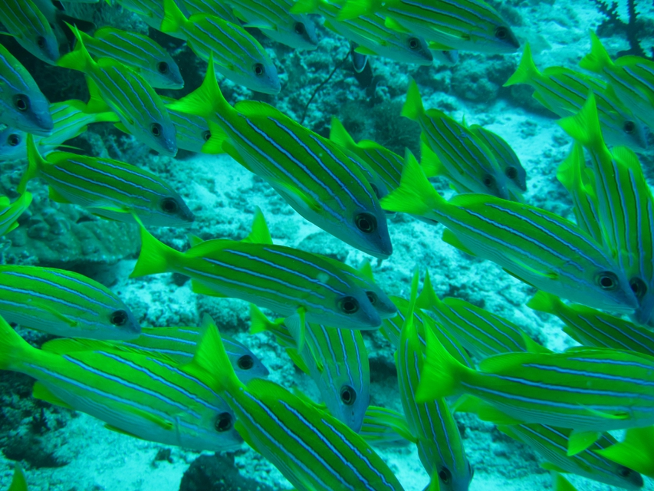



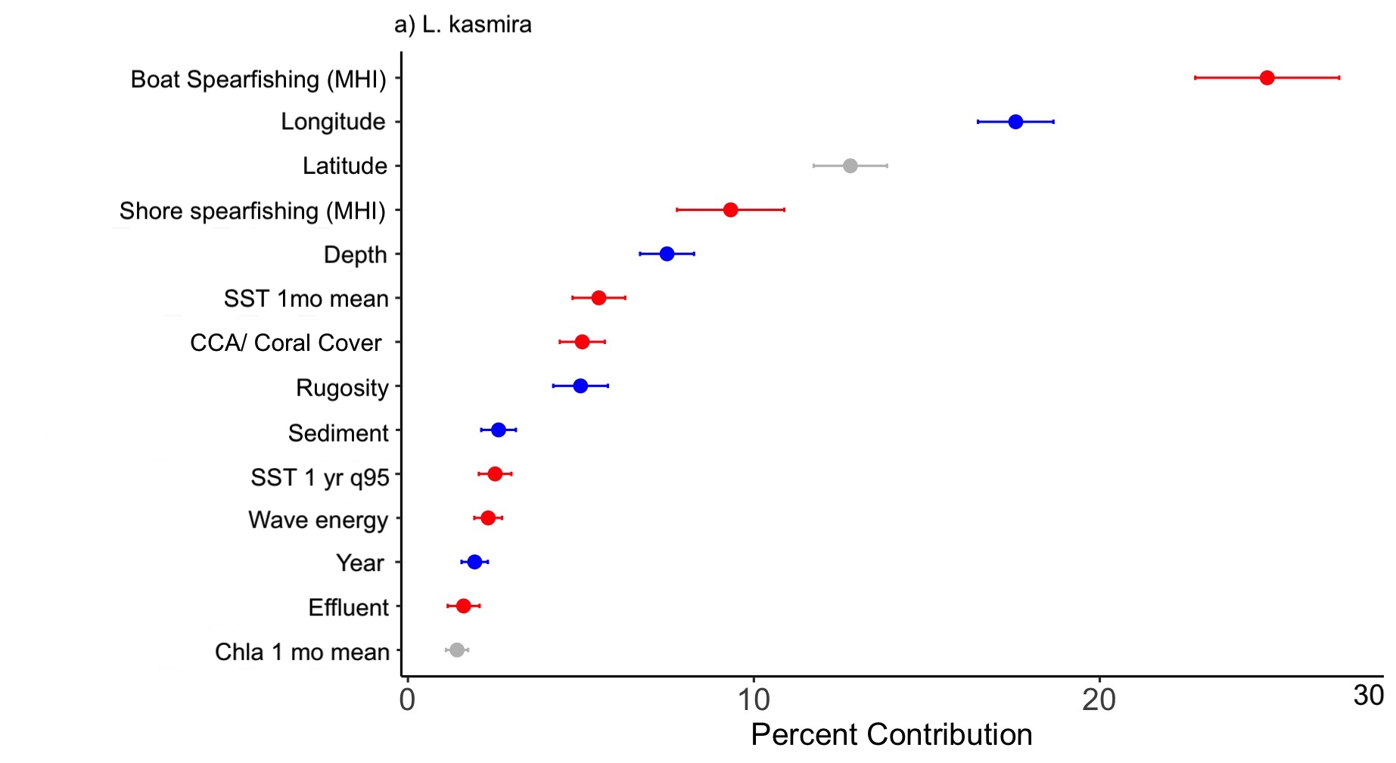
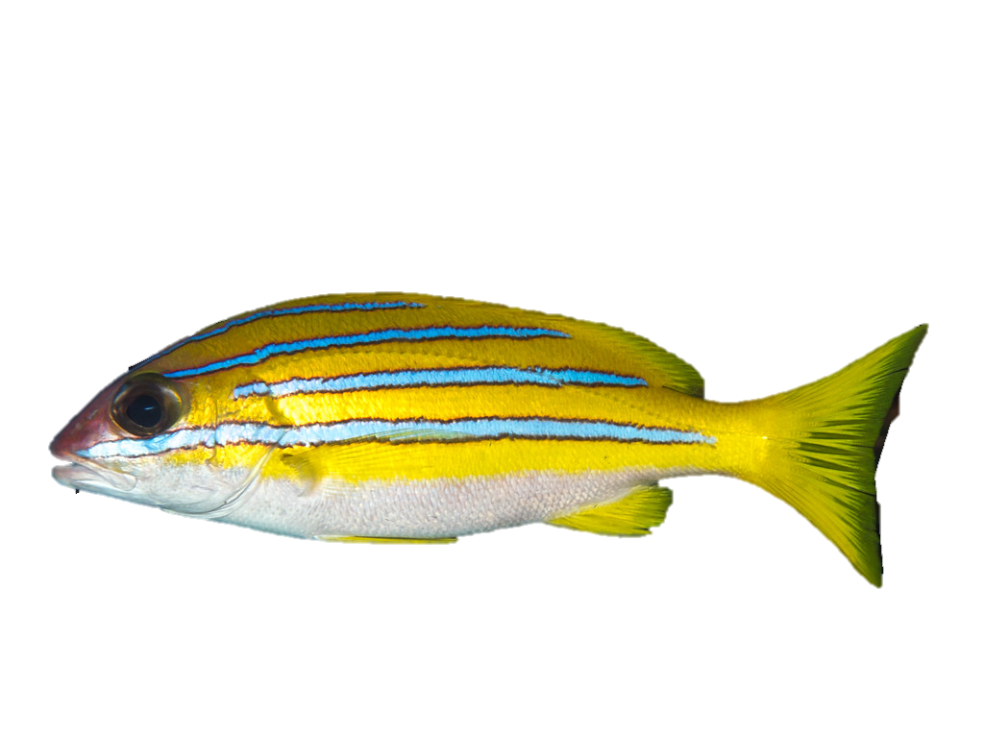
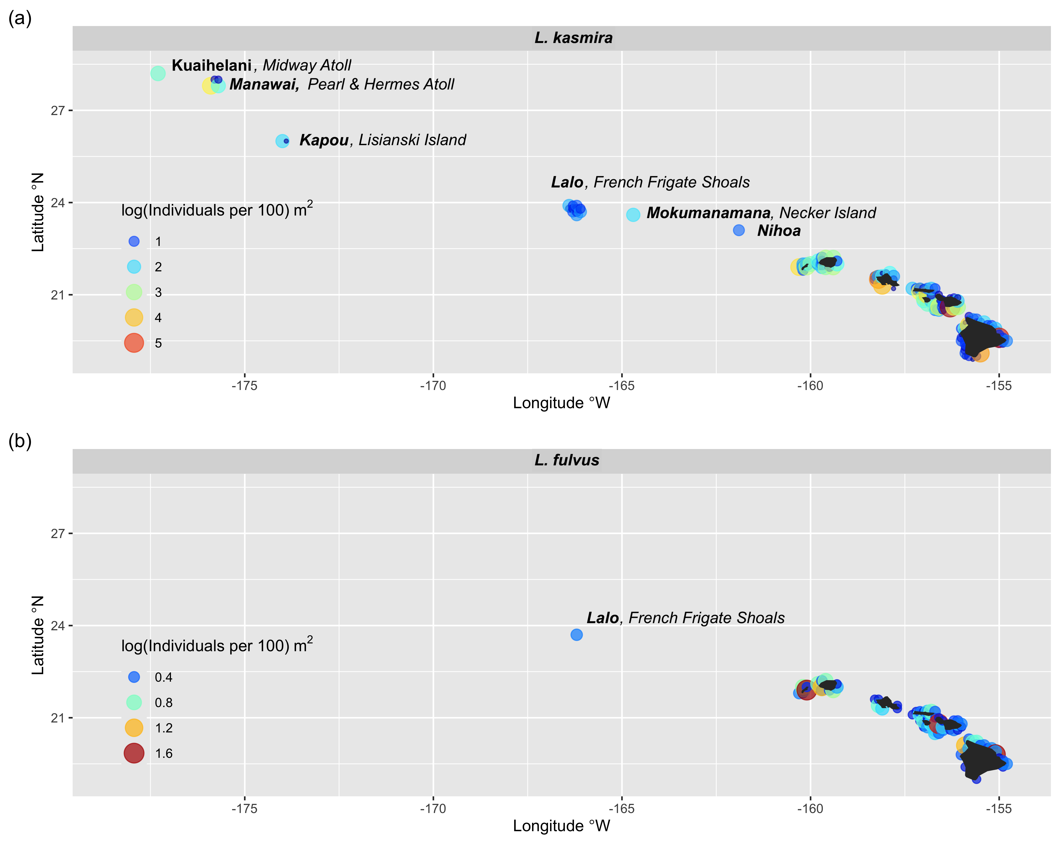
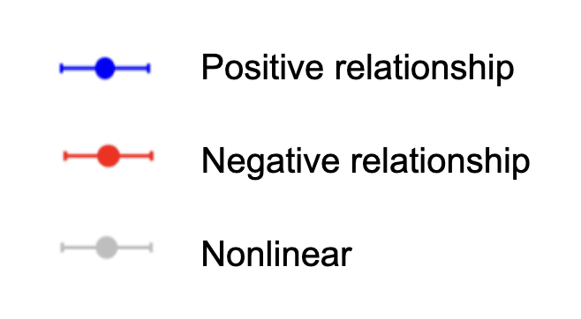
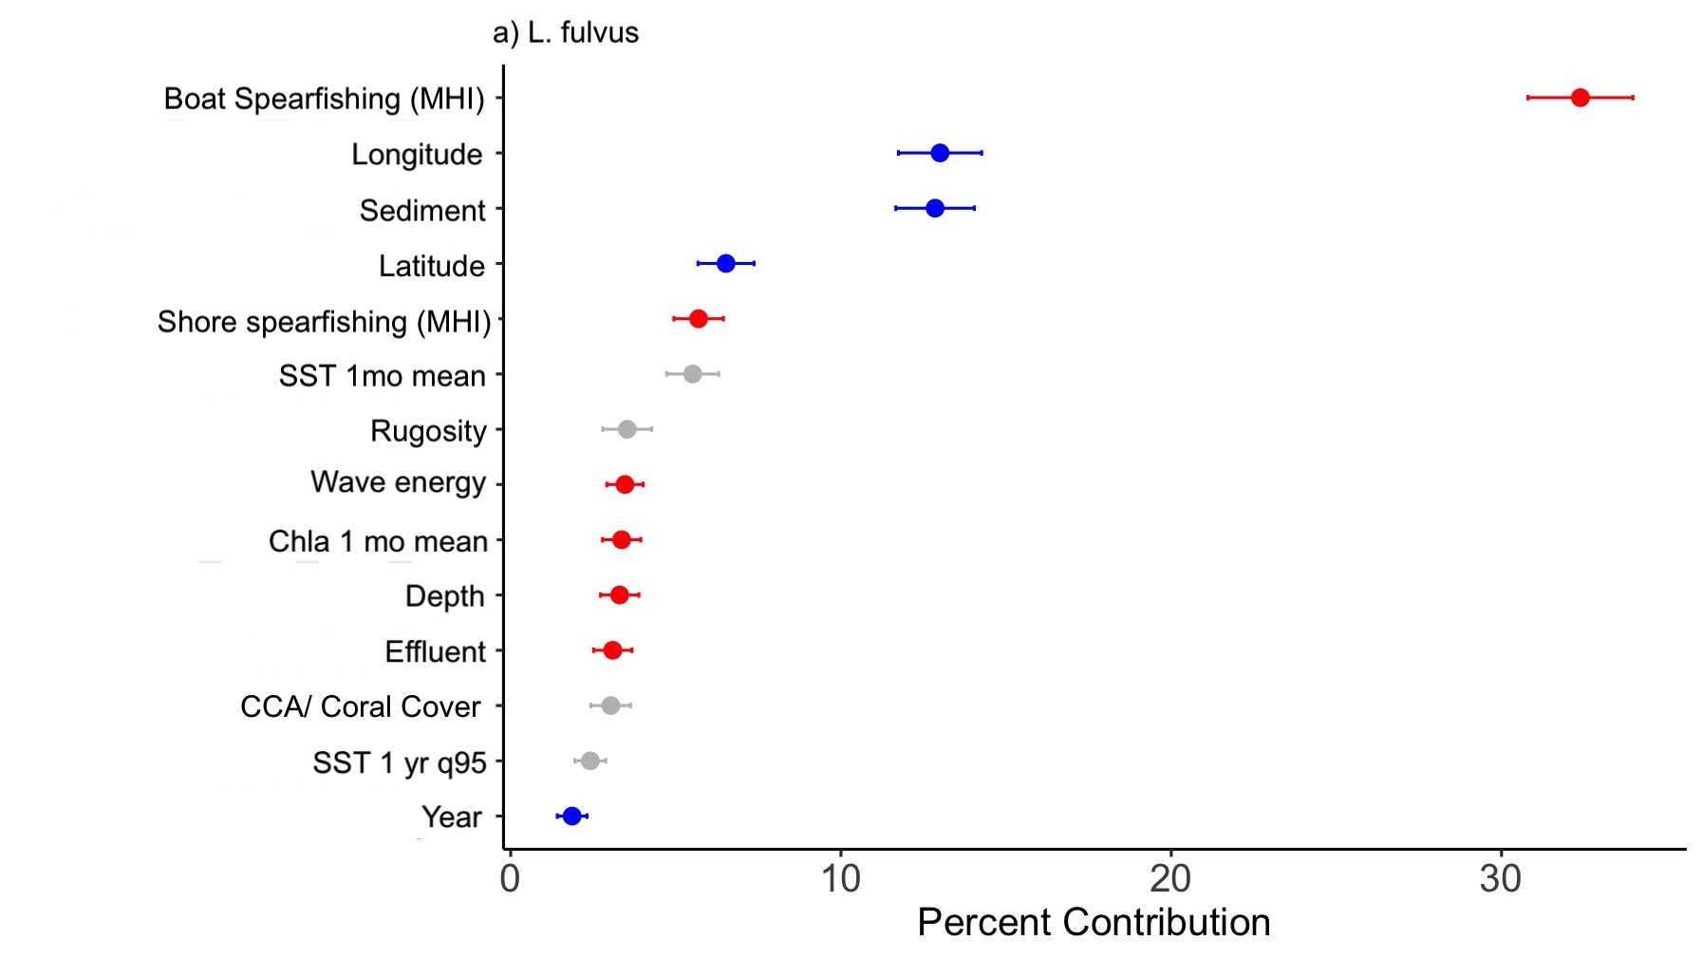
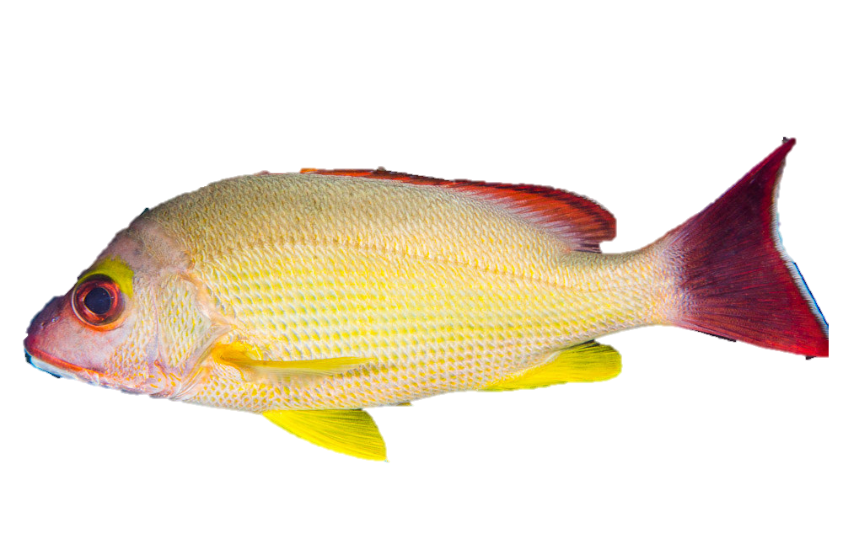
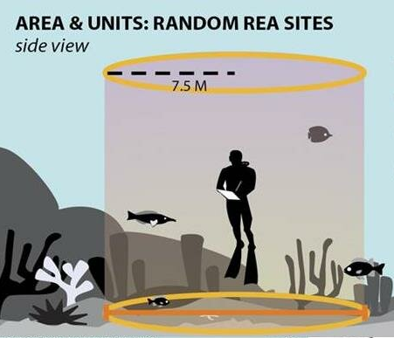
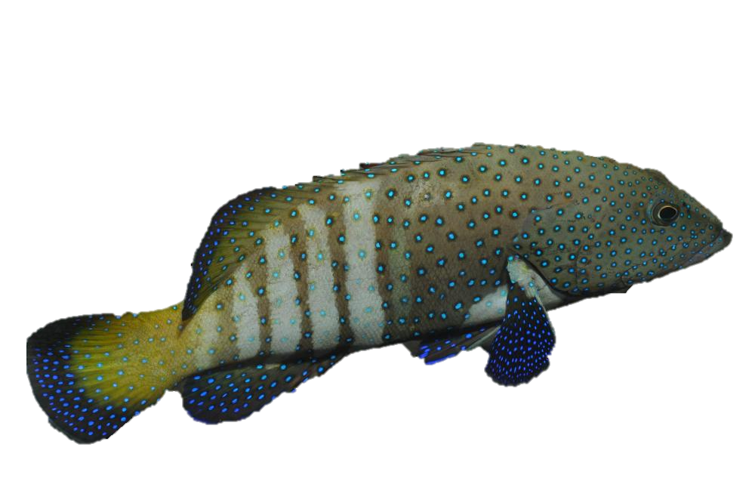
Species Distribution Modeling of Non-Native Snappers (Lutjanus spp.) in the Hawaiian Archipelago
Maya S. Otsu^{1*}, Justin J. Suca^{2,3,4}, Jessica N. Perelman^{3,4},
Kisei R. Tanaka⁴ and Lillian J. Tuttle Raz⁵
¹Marine Biology Graduate Program and Hawaiʻi Cooperative Fishery Research Unit,
University of Hawaiʻi at Mānoa, otsumaya@hawaii.edu*,
²University of Hawaiʻi at Mānoa, Department of Oceanography,
³Cooperative Institute for Marine and Atmospheric Research,
⁴NOAA Pacific Islands Fisheries Science Center,
⁵U.S. Geological Survey, Hawaiʻi Cooperative Fishery Research Unit, University of Hawaiʻi at Hilo
BACKGROUND
PRELIMINARY RESULTS
Bluestripe Snapper or Taʻape (Lutjanus kasmira) and Blacktail Snapper or Toʻau (L. fulvus) were introduced to Hawaiʻi in the 1950ʻs from French Polynesia for fisheries enhancement.¹
Both species are loosely considered “invasive” despite mixed evidence of competition with and predation on native species.
L. kasmira observed at shallow waters at all islands/atolls of the Main Hawaiian Islands (MHI) and Northwestern Hawaiian Islands (NWHI) except ʻŌnū (Gardner Pinnacles), Kamole (Laysan Island), and Kamokuokamohoaliʻi (Maro Reef)². Not observed at mesophotic depths (45-100 m) beyond Lalo (French Frigate Shoals), where reefs are dominated by endemic fish³ (Fig. 1).
L. fulvus observed in shallow waters (<45 m) only, up to Lalo (Fig. 1).
OBJECTIVES
45 m
100 m
45 m
100 m
Figure 1. L. kasmira and L. fulvus distribution and abundance across the Hawaiian Archipelago. (a) Distribution of L. kasmira in
NWHI extends past Lalo up to Kure Atoll (~2250 km NW of Honolulu) (b) Distribution of L. fulvus in NWHI ends at Lalo (~885 km NW of Honolulu). Figure adapted from Kosaki et al. (2017)³. Note that the scales between the two species are different.
Figure 3. Mean percent contribution (± s.d.) of environmental and anthropogenic variables to the presence or absence (P/A) of (a) L. kasmira and (b) L. fulvus determined by ensemble boosted regression tree models. Colors represent the relationship between the predictor variables and the P/A responses, where blue indicates a positive relationship, red indicates a negative relationship and gray indicates a relationship that is not clearly linear. The percent contribution is a measure of each predictor variables importance to the overall model fit.
OBJECTIVE
Quantify how environmental and anthropogenic variables drive differential distribution patterns between L. kasmira and L. fulvus and how the patterns differ across spatial and temporal scales.
DISCUSSION
METHODS
Human influences
The most significant predictor of L. kasmira and L. fulvus presence is boat-based spearfishing, indicating a strong negative association between encounter probability and fishing effort.
Shore-based spearfishing is also an important negative predictor for both species.
Habitat influences
L. kasmira presence is positively associated with depth and rugosity but negatively with coral cover, which indicates they may prefer deeper, cooler edge habitats with structural complexity.
L. fulvus is more likely to be in higher sediment habitats, potentially indicating association with freshwater outflows.
The presence of both L. kasmira and L. fulvus is heavily influenced by latitude and longitude, which may indicate the influence of underlying spatial processes from variables that are not currently represented in the model (i.e., upwelling, trade winds, and biological processes like dispersal).
There are no standardized species datasets at mesophotic depths, so our ability to understand what is going on beyond 30 m is limited.
Lack of freshwater input due to less complex topography in the NWHI may be contributing to lower L. fulvus presence.
Implications
Spearfishing could impart control on both populations, given the strong influence it seems to have on the presence of these invasive species.
Changing climate conditions such as warming temperatures may have a relatively small impact on L. kasmira and seems unlikely to outweigh other drivers.
Species Distribution Models using Ensemble Boosted Regression Trees (BRTs):
Hybrid statistical/machine learning approach to deal with numerous predictors and complex relationships
Cross validated using a 75/25 split (75 to train the model, 25 to validate)
50-model ensemble
Species Dataset:
NOAA National Coral Reef Monitoring Program (NCRMP) Dataset⁴
SCUBA-based Stationary Point Count (SPC) surveys, n=8944
Randomized hard bottom location at depths of 0-30 m
Paired 15-m diameter cylinders (Fig. 2)
Photographs of benthos taken along transects
2009-2021 (every 3 years) across MHI and NWHI
Environmental Datasets and Tools:
NOAA Environmental Data Summary (EDS)⁵⁻¹²
Integrates field survey data with gridded environmental data (Table 1)
Ocean Tipping Points (OTP)¹³
Figure 2. Diagram of divers conducting an SPC survey.
Table 1. Descriptions of environmental and anthropogenic variables included in ensemble boosted regression tree models.
Predictor | Metric | Resolution | Justification
Sea Surface Temperature (SST)⁶ | Mean | Monthly, 5 km 1985-present | Thermal preference, tolerance
 | Q 95 | Annual, 5 km | Upper thermal limit, heat event
Chlorophyll a (Chla)⁷ | Mean | Monthly, 5 km 1997-present | Food availability/productivity
Depth⁸ | Meters | At survey site | Depth constraints, temperature gradients
Rugosity^{9, 10, 11} | SD of bathymetry | Climatology 0.1 km (MHI) 0.5 km (MHI & NWHI) 0.5 km (MHI) 0.6 km (NWHI) | Habitat preference
Coral cover⁸ | % cover |  | Habitat preference
Wave energy¹² | Total kinetic energy (TKE) | 3 hours, 4 km 2009-2020 | Feeding zones, food delivery mechanisms, aggregations at certain flows
Spearfishing effort¹³ (Boat- & shore-based) | Hours/ha | -- | Human fishing pressure effects on populations
Effluent⁸ | g/km²/day | -- | Water quality, habitat disturbance
Nearshore sediment¹³ | Ton/ha/yr | 0.5 km | Reef degradation, changes in temp/salinity
Latitude, Longitude⁸ | Degrees | -- | Temperature gradients
Year⁸ | -- | -- | Annual variability
NEXT STEPS & FUTURE DIRECTIONS
Run models with abundance as response variable (separate from presence/absence, P/A, models) to better understand drivers of differential distribution.
Combine P/A and abundance results in hurdle models to predict fish abundance across the entire spatial domain and in changing climate scenarios.
Include Peacock Grouper or Roi (Cephalopholis argus, shown right) as a third major invasive species in the Hawaiian archipelago.
Share results with local fishing community to encourage development of a sustainable fishery.
ACKNOWLEDGMENTS AND REFERENCES
Thank you to Dr. Randy Kosaki (NOAA PIFSC), and Gabi Mukai (University of Hawaiʻi at Mānoa) for their extensive knowledge and support. This project was funded by the Hauʻoli Mau Loa Foundation. The Hawai'i Cooperative Fishery Research Unit is jointly sponsored by the U.S. Geological Survey, the University of Hawai'i System, the Hawai'i Department of Land and Natural Resources, and the U.S. Fish and Wildlife Service. Use of trade, product, or firm names is for descriptive purposes only and does not imply endorsement by the U.S. Government.
¹Parrish et al. (2000) Interactions of Nonindigenous Blueline Snapper (Taape) with Native Fishery Species: Final Report. ²Fukunaga et
al. (2017) Distribution and abundance of the introduced snapper Lutjanus kasmira (Forsskål, 1775) on shallow and mesophotic reefs on the Northwestern Hawaiian Islands. Bioinvasion Records 6(3), 259-268. ³Kosaki et al. (2017) Scientists Discover Large Taʻape-
Free Zone on Deep Coral Reefs of the Northwestern Islands, Hawaii Fishing News. ⁴Ayotte et al. (2015) Standard Operating Procedures: Data Collection for Rapid Ecological Assessment Fish Surveys. ⁵Couch et al. (2023) Ecological and environmental
predictors of juvenile coral density across the central and western Pacific. ⁶Coral Reef Watch (CRW). ⁷European Space Agency Ocean Color Climate Change Initiative (ESA OCCI). ⁸National Coral Reef Monitoring Program (NCRMP). ⁹National Geophysical Data Center Coastal Relief Model. ¹⁰National Centers for Environmental Information (ETOPO). ¹¹Pacific Islands Ocean Observing System
(PacIOOS). ¹²Regional Ocean Modeling System (ROMS). ¹³Ocean Tipping Points (OTP PacIOOS).

